Slide 1
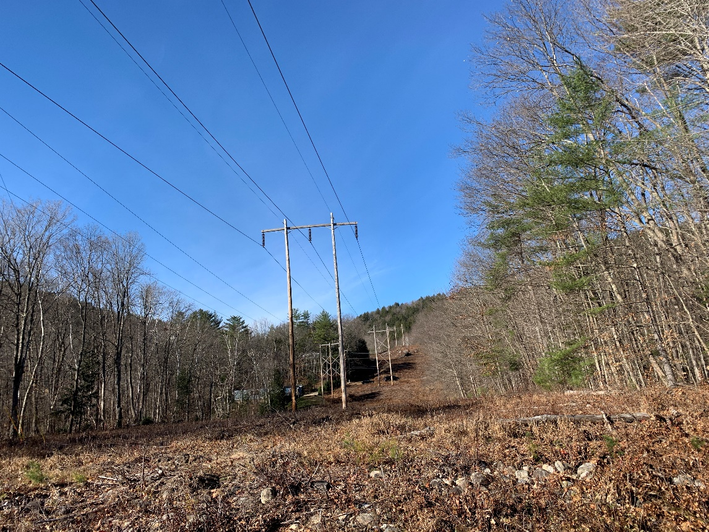
Eversource Woodstock to Sugar Hill (X178-2) Project – Phase 1 Existing X178-2 Transmission Line (Woodstock, Easton and Sugar Hill, New Hampshire)
New Hampshire Department of Environmental Services File Number 2024-00468 Public Hearing, June 21, 2024

Slide 2
Project Team
X178-2 Eversource Project Team
Project Manager: Samuel Harris/Brad Newell
Construction Representative: Jared Meyer
Licensing & Permitting: Kurt Nelson
Environmental Consultant: Lindsey White, GZA
Project Services: Jennifer Codispoti

Slide 3
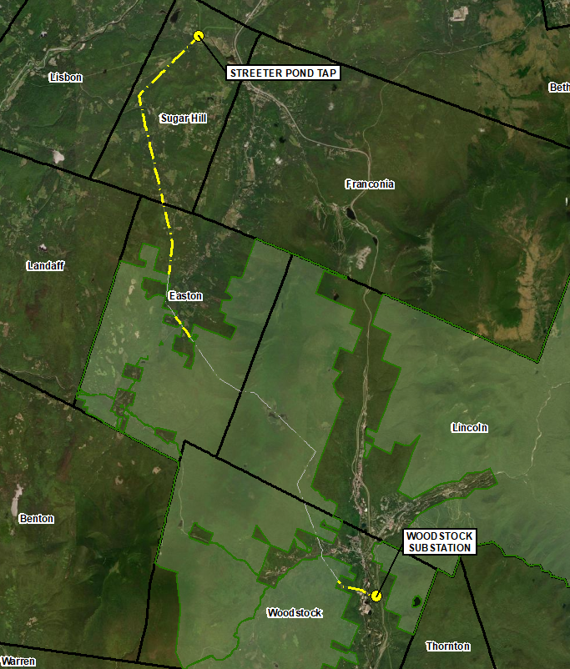
Project Overview A safer, more resilient, more reliable system
The X178-2 Phase 1 Project Will:
Replace the older, degrading existing wooden H-frame structures with new weathering steel H-frame structures.
Install new conductors and a new optical ground wire.
Be built to meet present-day electrical safety standards and code.
Collectively provide a safer, more resilient and more reliable electric supply.

Slide 4
Field Surveys
October 2022, Walkdown: Constructability Field Survey performed to identify access routes and work areas based on topography, natural resources, and other constraints with goal of avoiding and minimizing impacts to sensitive features while providing safe work conditions for live line construction.
November & December, 2022/May 2023, Wetland Delineation Confirmation: Wetlands along the full length of the ROW were confirmed (GZA) to support select structure replacements.
May 2023/May 2024, Vernal Pools: Vernal pool survey completed to evaluate potential vernal pools identified during wetland delineation. Additional vernal pool survey completed in 2024 as part of the RFMI response.
August 2022, Cultural Surveys: Archaeological Field Surveys performed by Independent Archaeological Consulting, LLC to identify sensitive historical and cultural resources.
June/July 2024, Above Ground Architectural Surveys: Above ground archaeological survey being completed by Preservation Company. Results to be incorporated into USACE permit application.

Slide 5
Project Permitting
NHDES Standard Dredge and Fill Wetland Application: Under Review, NHDES 2024-00468
USACE Pre-Construction Notification: Pending
NHDES Alteration of Terrain: Approved, AoT-2597
NHDES Shoreland Permit by Notification: Pemigewasset River, Woodstock, NHDES 2024-01405 & Gale River, Sugar Hill, NHDES 2024-01406
NHDOT Driveway Permits: in-ROW entrances approved, off-ROW entrances pending
NHDHR Request for Project Review: Above ground architectural survey underway, results to be provided to NHDHR for final review and recommendations and will be provided to USACE per Section 106 requirements.
EPA CGP/SWPPP: Pending
Local: Pending

Slide 6
Agency Consultation
NH Department of Environmental Services: Pre-application meeting held with NHDES and EPA January 18, 2024.
NHFG Consultation under Fis 1004: Wood turtle identified in the vicinity of the X178-2 ROW in Easton. NHFG BMP recommendations have been incorporated into project plans and incorporated into the AoT permit application for approval.
NHB Consultation: NHB identified the presence of a high-elevation spruce-fir forest system natural community outside the proposed project area. NHB did not identify concerns for the natural community for the proposed project.

Slide 7
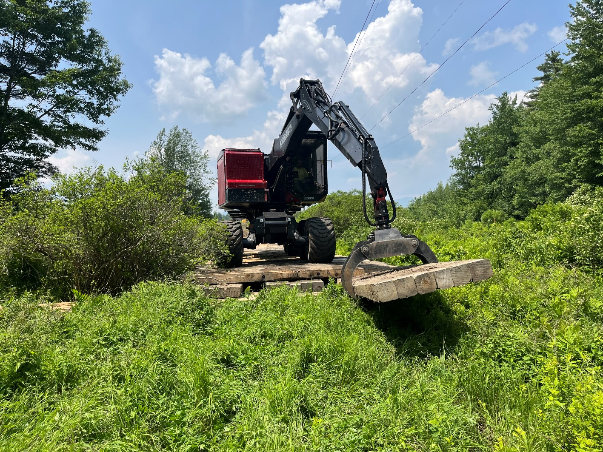
Construction Sequence
General Construction Sequence as follows:
Phase 1- Installation of erosion and sediment controls and reflagging of resources ahead of the start of construction
Phase 2- Begin civil construction to build access roads and work pads
Phase 3 – Drilling for new structure locations and install cans
Phase 4 – Install new structures, cross arms and hardware and transfer existing wires to the new structures, removal of the old structures (cutting structure at ground level in wetlands or removal in uplands)
Phase 5 – Pull the new Optical Groundwires and conductors into place and secure
Phase 6 – Restoration and monitoring for stabilization.
Construction Schedule
Construction anticipated to begin Fall 2024 and extend approximately one year
Timber matting installation on a transmission line in Tamworth, NH

Slide 8
Wetland Impacts
Temporary Wetland Matting: 468,776 square feet (~10.76 acres) of timber mats proposed to be installed in wetlands to provide access to structures along the full length of the ROW.
Permanent Impacts:
Poles within wetlands: 1,275 square feet of permanent impacts associated with pole installation in wetlands
100 square feet of permanent impacts within a PRA wetland adjacent to a Tier3+ stream (Wetland SH-25) associated with drilling disturbance and backfilling for new poles.
Temporary Wetland Grading: 400 sq. ft. in Wetland SH-46.1
Organic soils to be removed and temporarily stockpiled out of jurisdiction to be used to restore wetlands after construction. Filter fabric to be placed in proposed access as a barrier for placement of stone for a temporary road base. Stone to be removed and restore wetland to preexisting grades to the greatest extent.
Impacts to the bed and banks of streams will be avoided. Streams will be spanned and/or follow the Utility BMP Manual.
Vernal pool depressions will be avoided.

Slide 9
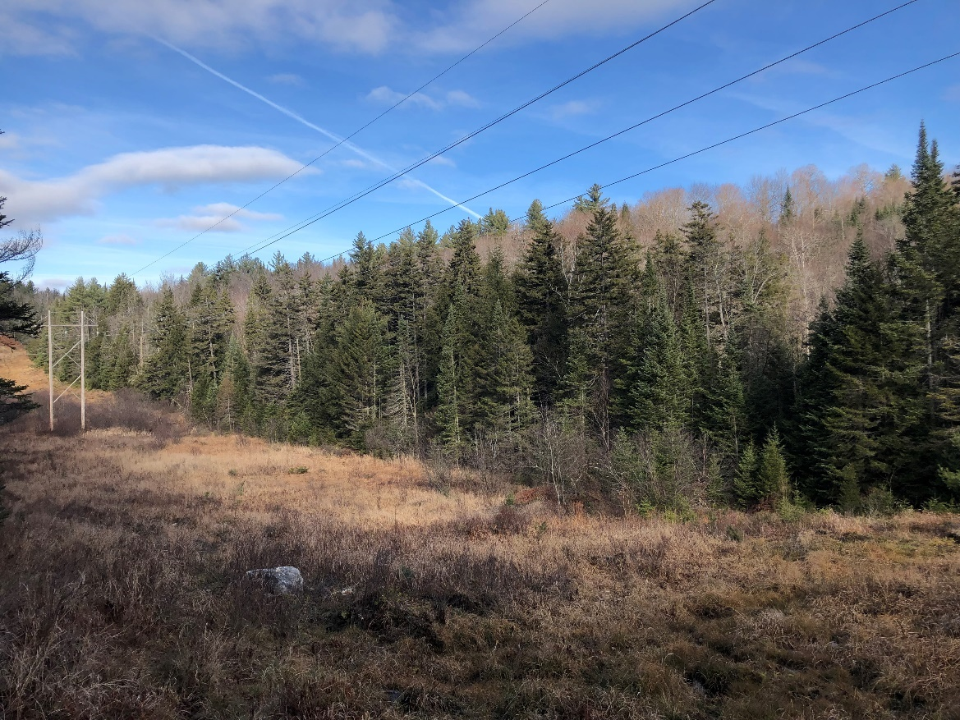
Avoidance and Minimization
Where possible, cross wetlands at narrowest location
Low distribution lines and steep topography within the ROW sometimes prevent this
Where landowner permission allows, utilize off-ROW access roads to avoid and minimize resource crossings
Consider wetland functions and values in project design
Where possible, avoid open or flowing water and wildlife habitat, such as vernal pools
Where possible, follow previously used access routes and/or existing trails to minimize new disturbances within wetlands, while also considering the recreation use of the area (snowmobile trails, hiking trails, OHRV trails)
Avoidance and minimization specific comments from NHDES, received in the RFMI, were incorporated into the project plans where possible
Temporary wetland matting impacts have been reduced by approximately 8,058 sq. ft. by removing access between proposed Structures 358 and 359 in Wetland SH-25
View of existing Structure 354 within Wetland SH-25.

Slide 10
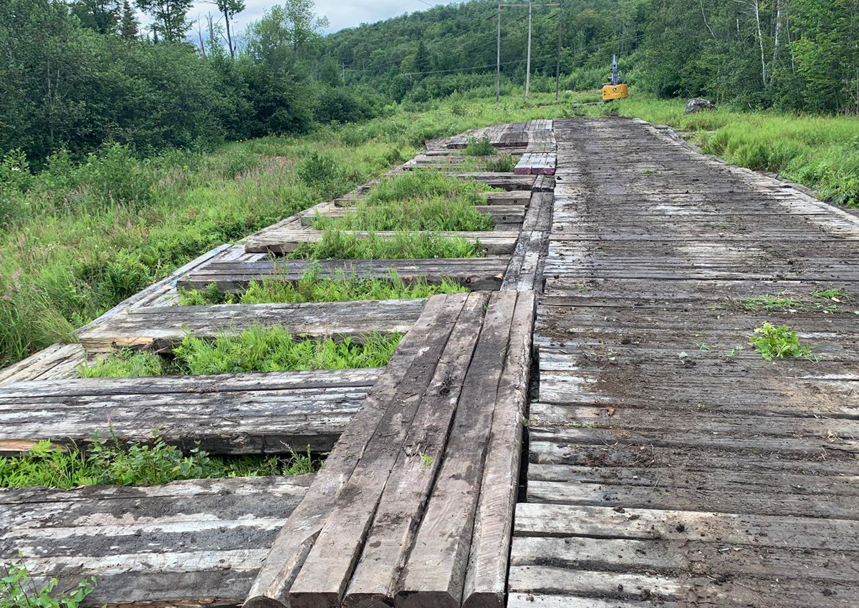
Wetland Matting
Elevated Matting – Mat Layering
Matting technique used in wetlands with saturated soils or inundation
Multiple layers of mats with “runners” placed on the wetland surface to reduce overall footprint and disturbance and elevate work and travel surfaces
Retains wetland functions and prevents loss of Flood Storage
Allows for hydrologic connectivity and aquatic organism and wildlife passage
Matting removed as soon as possible once work is complete along a segment of line.
Where possible, matting will not be in place for more than one growing season (continued on next slide)
Areas disturbed by matting are restored with light smoothing, as necessary, and stabilized with weed-free straw mulch

Slide 11
Wetland Matting Monitoring and Tracking
Wetland matting placement and removal tracked throughout construction
Within each wetland:
Record the date matting is initially installed
Ongoing documentation of matting and wetland conditions during construction from routine environmental monitoring visits, corrective actions or recommended maintenance communicated to contractors promptly
Record the date matting is removed
Record the date of restoration and stabilization
By December 31, 2024:
Provide NHDES and USACE with an update on wetland matting installed to date and the mat tracking process. Update the process, as needed, based on feedback
Within 90 days following completion of construction:
Provide NHDES and USACE with a report documenting the results of mat tracking, including a table showing the dates when matting was installed and removed in each individual wetland
If wetlands had matting installed for more than one growing season, or other lasting disturbances are observed, those matting areas will be identified in the report
A compensatory mitigation proposal will be included in the report, if necessary, to compensate for wetland impacts identified during monitoring and tracking

Slide 12
Proposed Mitigation
Compensatory mitigation - an in-lieu fee payment into the Aquatic Resource Mitigation (ARM) Fund
Proposed initial payment of $168,314.39 for 1,275 square feet of permanent wetland impacts associated with drilling disturbances and gravel backfill around poles installed in wetlands, 400 square feet of temporary grading impact in wetlands, and 33,028 square feet of temporary wetland matting in a PRA wetland.
*Mitigation total for gravel backfill around poles and temporary wetland grading to be updated based on NHDES comments
Based on the results of the wetland matting tracking and reporting, an additional ARM fund payment may be required. The proposed amount will be included in a separate mitigation proposal and based on impact areas (e.g. wetland matting in place for more than one growing season) identified during the monitoring and tracking effort, and NHDES and USACE permit conditions.
*Restoration Plan to be developed and included in mitigation proposal based on NHDES comments

Slide 13
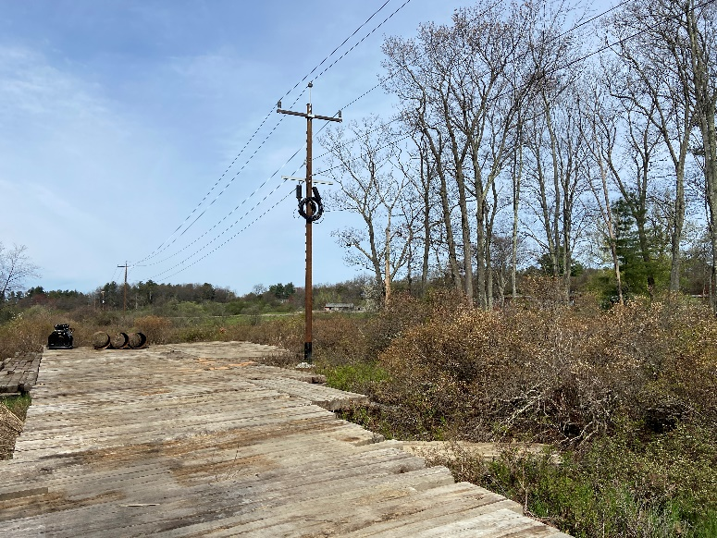
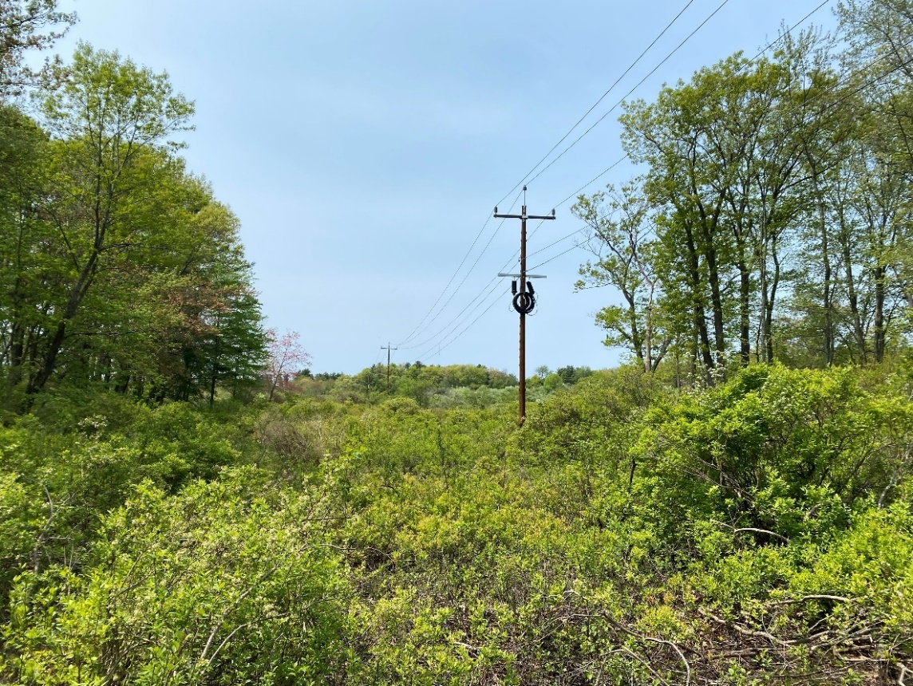
Environmental Compliance Monitoring
Stormwater Pollution Prevention Plan to be developed for the project
eNOI under the EPA Construction General Permit (CGP) to be filed for the project
Weekly environmental monitoring visits performed during active construction in accordance with the SWPPP and CGP
Additional visits performed after significant rain events or snow melt events, as necessary
Visits include inspection of erosion controls and site stabilization and adherence with permit conditions and BMPs, including wetland matting tracking
Corrective actions and maintenance items communicated directly to contractors and Eversource promptly
Post-construction monitoring visits performed as required by permit conditions and/or until permanent site stabilization is complete with restored areas having at least 85% vegetative cover of native species per NHDES Env-Wt 307.03(c)(6a)
Timber matting in a wetland April 2022 on a distribution line in Manchester, NH
Same wetland in May 2023

Slide 14
Public Outreach
Proactive communication with neighbors, businesses and all community members about project activities is very important to us. We will continue this outreach effort before and during the construction process in the following ways:
NH Project Hotline: Members of the general public can call or email with questions – all inquiries are promptly answered. 1-888-926-5334 or NHProjectsInfo@eversource.com
Project Signage: Positioned at various construction sites, to share our Hotline and Email address information for any questions from abutting property owners or the general public.
Project Website: To share project information, including maps, schedule updates, construction status, and contact information. Beebe River to Whitefield (X178) Line Rebuild Project | Eversource

