Slide 1
Webster - Beebe River 115 kV Corridor Asset Condition and OPGW Project – Lines A111, E115 and Z180
TCA Submittal Presentation
NEPOOL Reliability Committee Meeting
March 15, 2023

Slide 2
Agenda
Project Background
Project Location
Project Need
Summary of Work

Slide 3
Project Background
This presentation covers asset condition replacements and OPGW installation projects on Eversource’s 115-kV lines which was presented at the December 16, 2020, PAC meeting
Includes 3 full line rebuilds in Eversource’s New Hampshire service territory within the Webster substation to Beebe River substation corridor
Project Drivers
Inspections indicated significant degradation and decreased load carrying capacity of wood H-frame structures (70 years old), deficiencies include:
Split pole tops and cracks
Woodpecker damage
Deteriorating steel components
Due to severity of degradation of lines, full rebuild was selected as preferred solution as it was the most efficient and cost-effective alternative
The full rebuild included replacement of all wood structures, replacement of existing 336 ACSR conductor with 1272 ACSS conductor and replacement of existing shield wire with OPGW

Slide 4
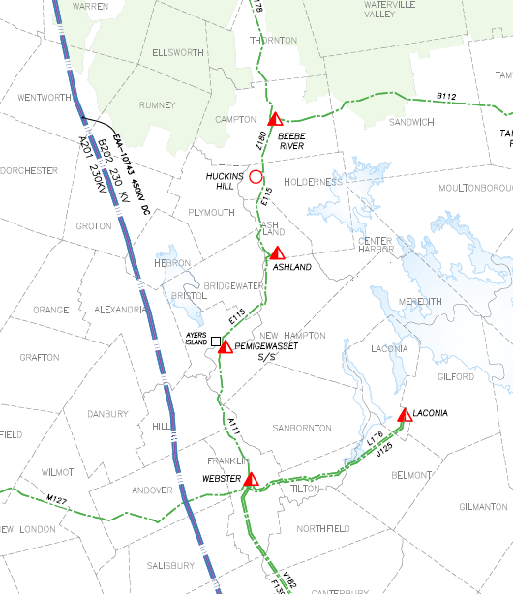
Project Location - NH
Z180
E115
A111

Slide 5
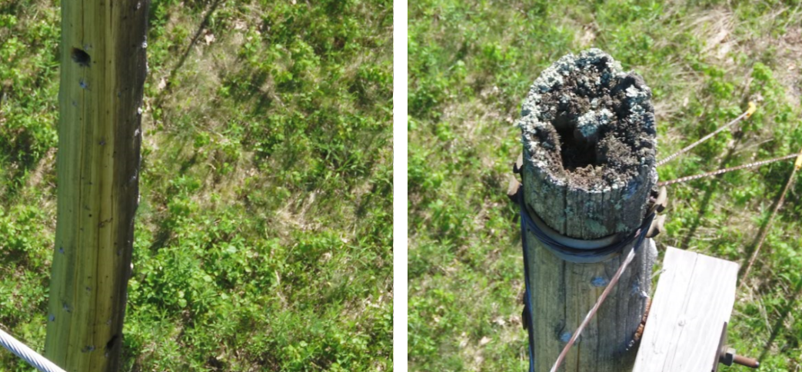
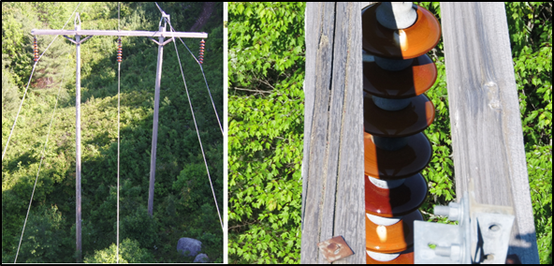
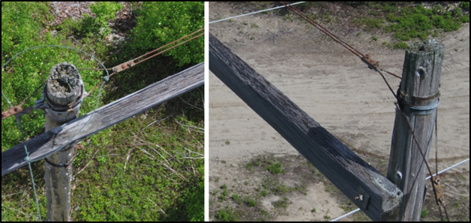
Project Needs: Wood Pole Asset Condition

Slide 6
Webster - Beebe River 115 kV Corridor Asset Condition and OPGW Project Summary – TCAs
Webster - Beebe River 115 kV Corridor Asset Condition and OPGW Project – Lines A111, E115 and Z180
**Presented to ISO-NE PAC December 16, 2020
State | Line | Voltage | TCA # | ACL# | Locations | TCA Cost ($M)
NH | A111 | 115 | ES-21-TCA-44 | 279 | Webster Substation - Pemigewasset Substation | $ 31.23
NH | E115 | 115 | ES-22-TCA-20 | 280 | Pemigewasset Substation – Huckins Hill Substation | 64.15
NH | Z180 | 115 | ES-23-TCA-01 | 281 | Huckins Hill Substation – Beebe River Substation | 14.53
Total Submitted TCA Cost Estimate |  |  |  |  |  | $ 109.91

Slide 7
Project Scope
Structure Replacement Scope:
A111 Line: Replace 116 wooden structures with self-weathering steel structures
E115 Line: Replace 176 wooden structures with self-weathering steel structures
E115 Tap (Ashland Tap to Ashland Substation) is non-PTF and is included in Eversource’s Local System Plan
Z180 Line: Replace 28 wooden structures with self-weathering steel structures
Installation of lightning arrestors and counterpoise on all three lines
OPGW Scope:
Replacement of 2 existing Shield Wires with OPGW on all three circuits
Reconductor Scope:
All three 115-kV lines will be reconductored with 1272 ACSS 54/19
A111 Line: Reconductor approximately 10.6 miles
E115 Line: Reconductor approximately 14.9 miles
Z180 Line: Reconductor approximately 3.4 miles
Estimated Cost = $109.91 Million

Slide 8
Questions

